Slide 1


ANALYZING AMAZON SALES DATA
TECHNOLOGIES : DATA SCIENCE DOMAIN : E-COMMERCE PROJECT DIFFICULTIES LEVEL : ADVANCED

Slide 2


INTRODUCTION
Amazon's sales strategy is a complex dance, less reliant on traditional salespeople closing deals and more focused on building a thriving marketplace ecosystem. Here, third-party sellers take center stage, listing products, fulfilling orders, and providing customer service. Data analysis plays a crucial role, informing decisions about product selection, competitive pricing, and targeted promotions. By prioritizing a user-friendly interface, lightning-fast fulfillment, and exceptional customer service, Amazon fosters a loyal customer base that keeps coming back for more, ultimately driving sales and solidifying its position as a retail giant.

Slide 3
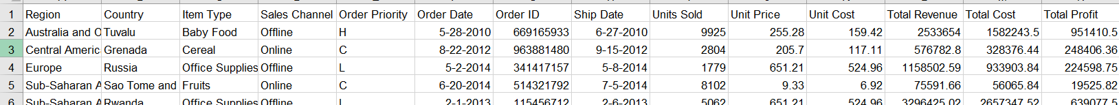
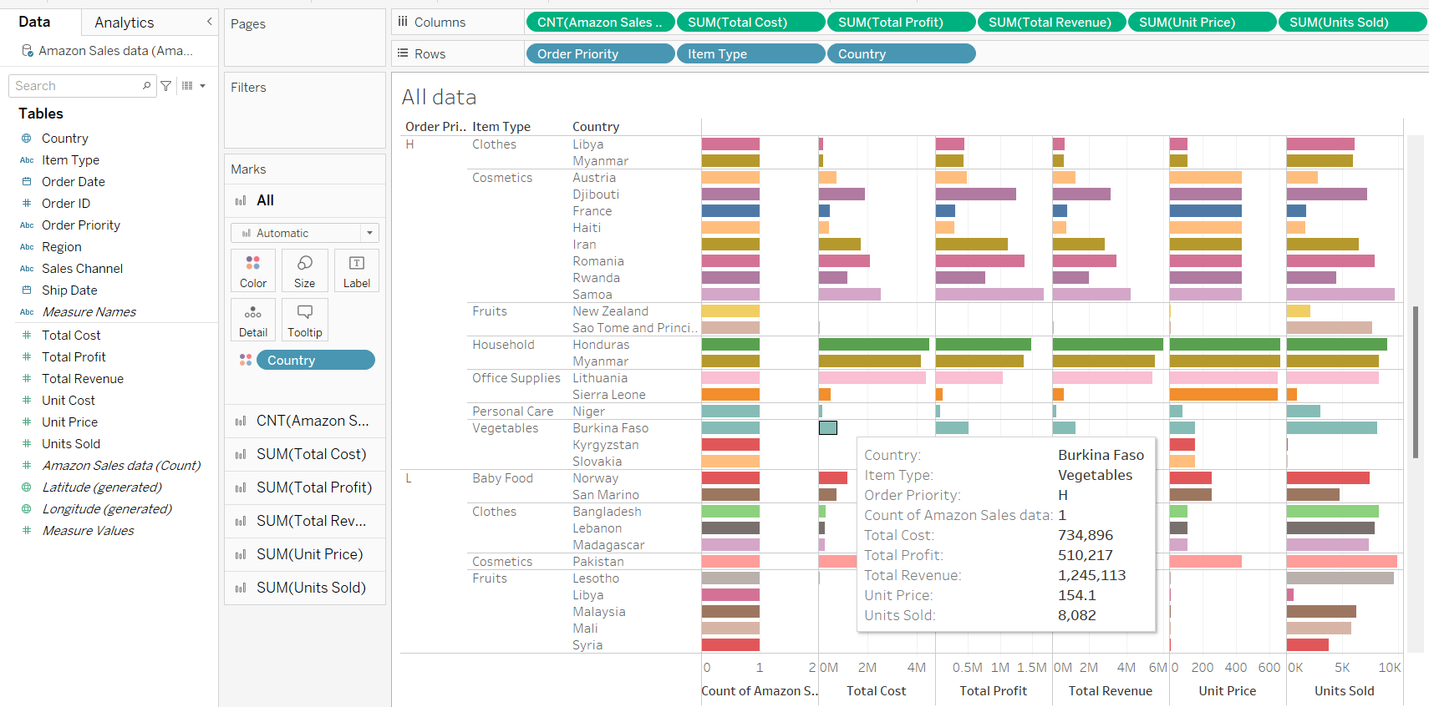
ABOUT DATASET
In this data set we can see that there are many fields and value from what we evaluated

Slide 4





MAIN KPIS
TOTAL REVENUE & TOTAL PROFIT
The total amount rung up at the cash register before any discounts or returns.
Revenue: The final amount kept by the company after subtracting those discounts and returns.
ITEM TYPE
Type of item category that includes Household, babyfood, beverages, office supply,fruits, clothes etc.,
ORDER DATE UNIT PRIZE
Order date is important field here as we have to analyse monhtly and yearly sales and unit prize

Slide 5

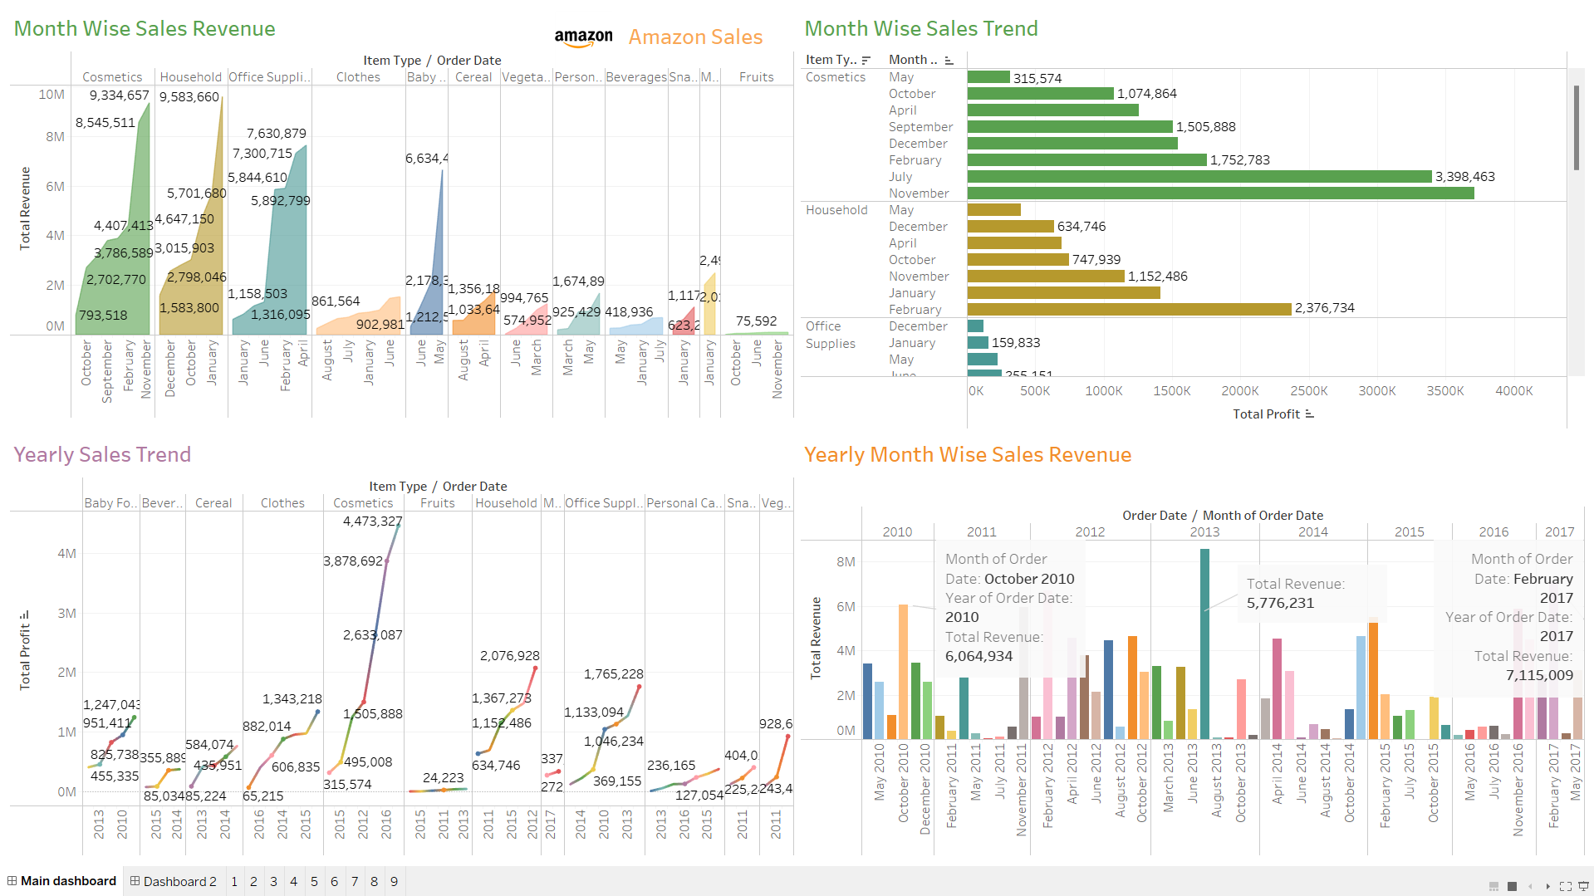
Sales Trend Dashboard

Slide 6
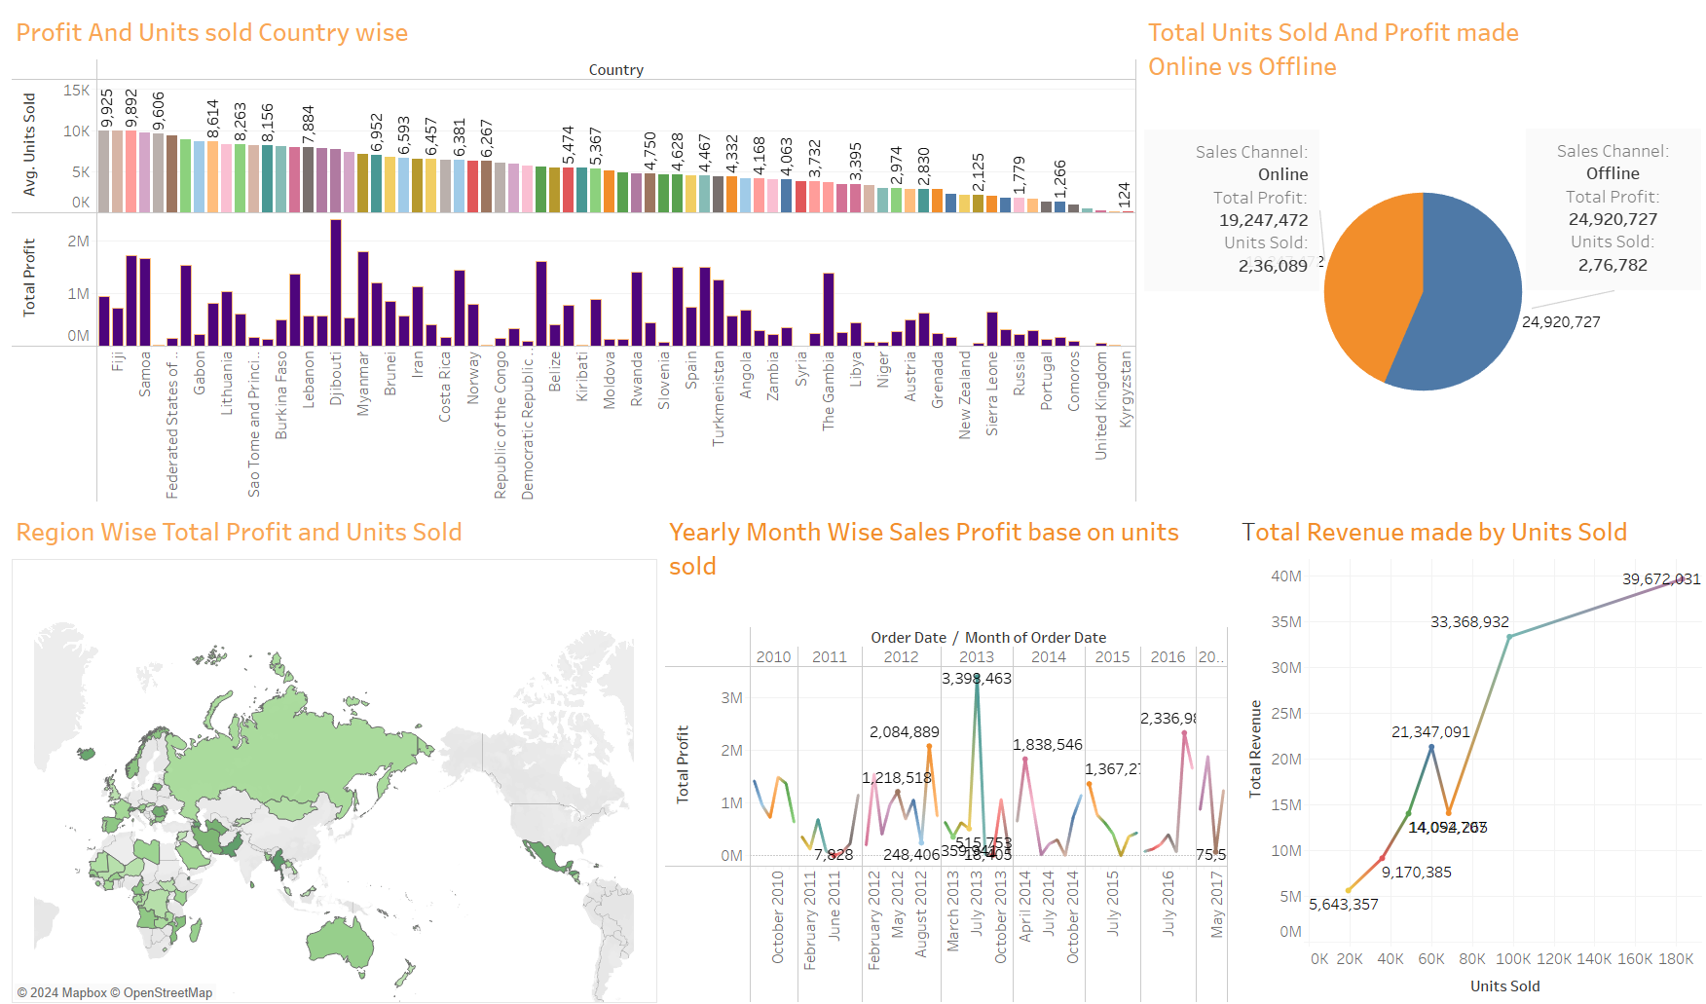
MY DESIGN

Slide 7

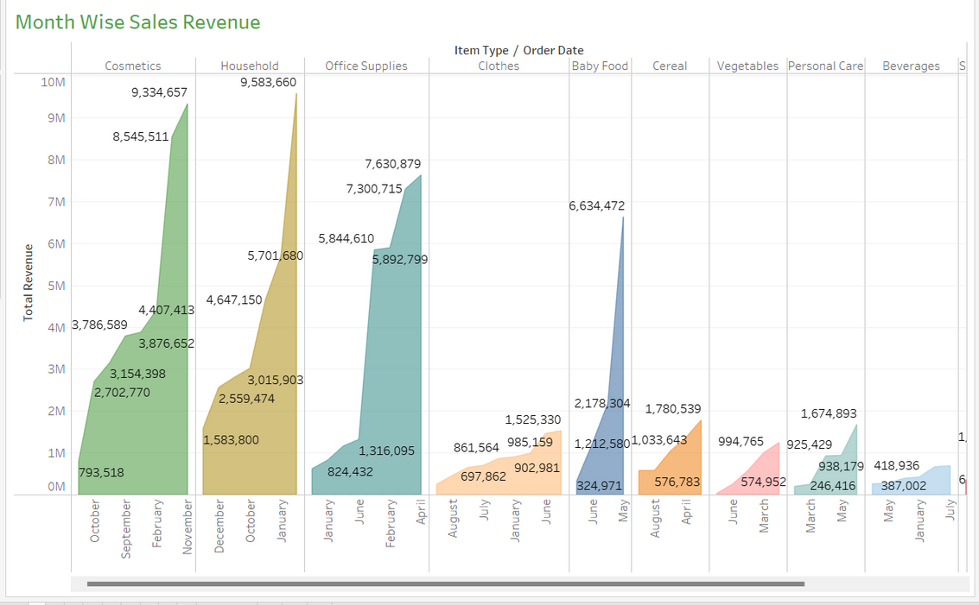
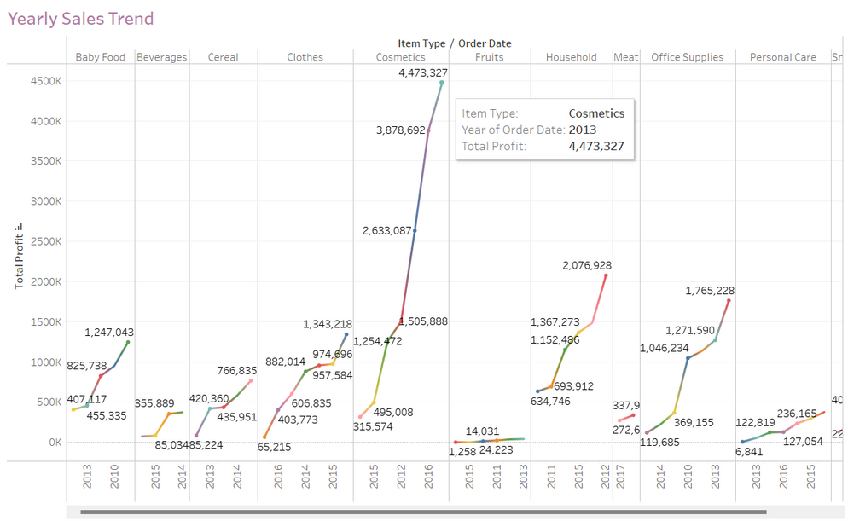
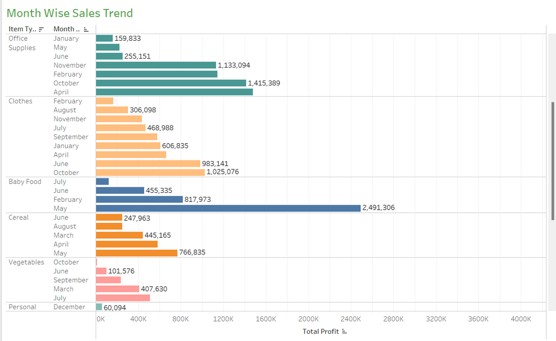
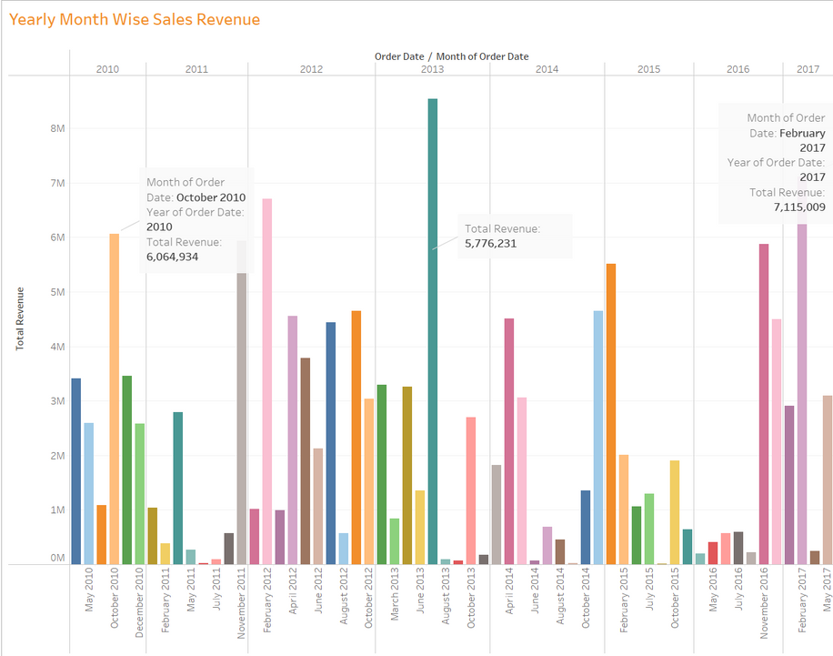
OTHER GRAPHS

Slide 8
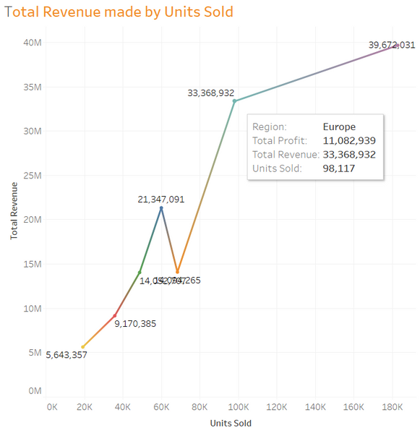
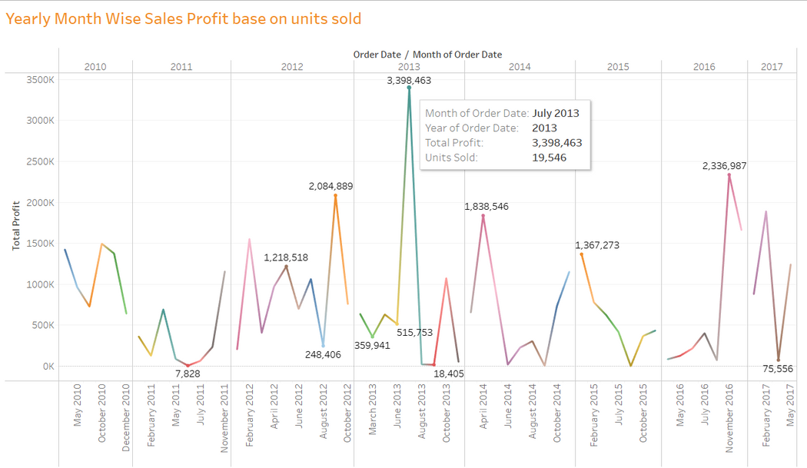
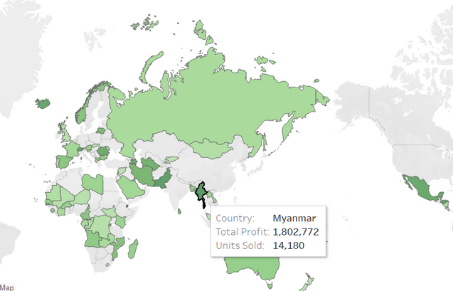
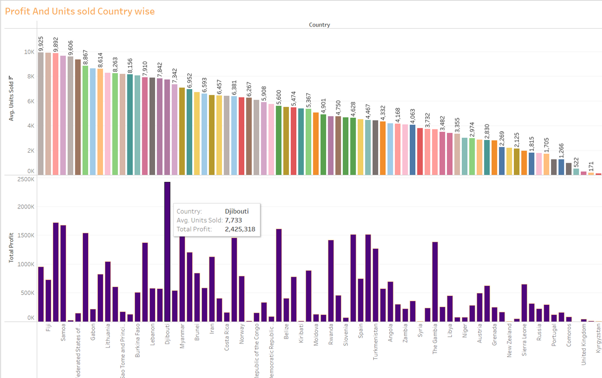
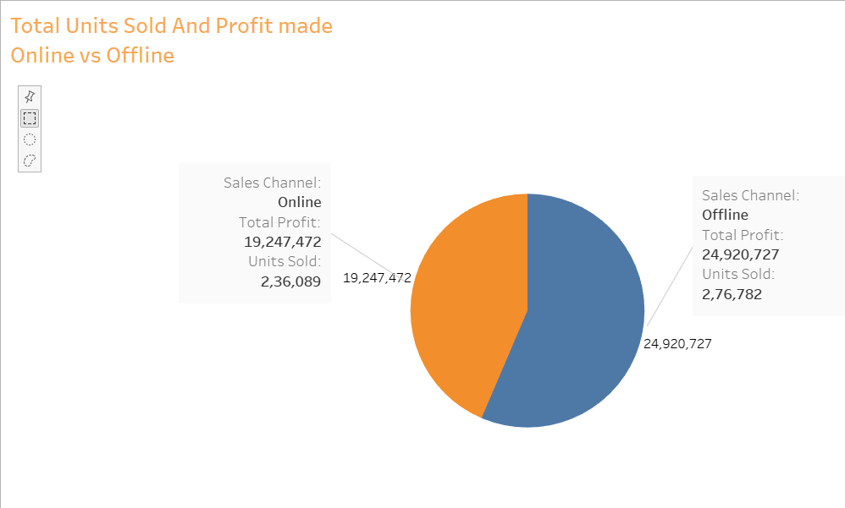
OTHER GRAPHS

Slide 9


THANK YOU
Visit my tableau public link and canva link
https://public.tableau.com/app/profile/vrajkumar.nandwana/viz/birdstrikesum/
https://www.canva.com/design/DAGJxwPMAW8/1DYOMqvN14bf8qAXkGyjdg/edit?utm_content=DAGJxwPMAW8&utm_campaign=designshare&utm_medium=link2&utm_source=sharebutton
Submitted by : Vrajkumar Nandwana
Internid:UMIP10996

